Slide 1
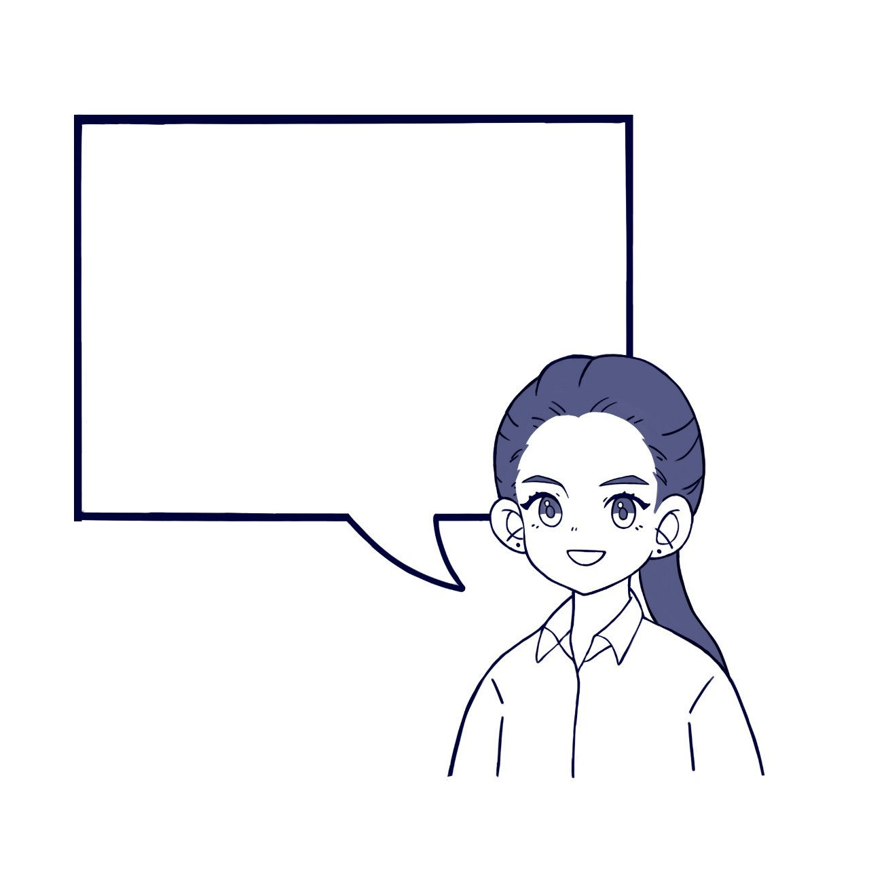
3-1 Good morning!
Nice to meet you.
My name is Thida.
I am so happy to meet you.
May I have your name?
Where are you from?

Slide 2
Do you like Cambodia?
Which country are you from?
I love your country very much.
Do you have time to talk with me?

Slide 3
Greetings
Good morning, teacher.
How are you?
We are studying English with you.
We are so happy to study English.
Would you lead us?
The more, the better.
We will study hard.

Slide 4
Interaction: How are you? Repeat 2 or 3 times, in order. 4 people
Hello. How are you?
I am fine and you?
Where are you from?
Yes, I love it very much.
Do you have time to talk with me?
I am from Nagoya, Japan.
Do you like my country?

